Slide 1
Air Quality Monitoring
Breathing Safely
Subtitle: An Overview of Air Quality and Monitoring Techniques
Swetha S (Leader)
Vijayalakshmi S
Meera S
Kaviya V
Keerthika E
Sivajothi R

Slide 2
Abstract
Air quality monitoring is a critical practice in today's world, driven by the increasing concerns over its profound impact on human health and the environment. This presentation explores the fundamental aspects of air quality monitoring in a 10-slide format

Slide 3
Introduction
Briefly introduce the concept of air quality and its importance.
State the objectives of the presentation.

Slide 4
Air Quality Monitoring - Breathing Safely
Air quality is a fundamental component of our daily lives, impacting both our well-being and the environment we inhabit. This presentation delves into the world of air quality monitoring, exploring its significance in safeguarding our health and the planet

Slide 5
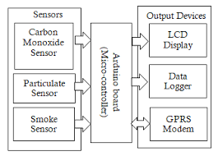
Block Daigram

Slide 6
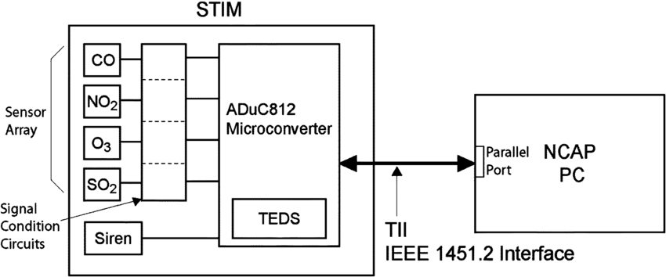
Circuit Daigram

Slide 7
Discription
Air quality monitoring refers to continuous measurement of specific air pollutants also known as “criteria air pollutants”. Obtained air pollution data together with natural background/trace gas monitoring and stationary source emission monitoring helps to define what kind of air pollution people are exposed to.

Slide 8
THANK YOU

